Slide 1
GenAI HW4 Become an AI Hypnosis Master
TA: 樊樺、呂睿超、林堅壬
ntu-gen-ai-2024-spring-ta@googlegroups.com
Deadline: 2024/04/04 23:59:59 (UTC+8)
Notes:
Become an AI Hypnosis Master 成为AI催眠大师

Slide 2
Outline
Links
NTU Cool HW4 Forum
HW4 Colab
Google Gemini
Overview
Task Introduction
Grading and Submission
Regulations
Colab
Hints
Notes:
Regulations 规定

Slide 3
Overview

Slide 4

Objectives
Design prompts that improve Gemini's accuracy in solving mathematical problems.
Understand how prompts affect the performance of a Large Language Model (LLM).
An artist is creating a large mosaic using square tiles. The mosaic is designed to be a square itself and to contain exactly 3 times…….
Alright class, listen up! Today we're helping an artist with their mosaic project …
So the answer is 171 blue tiles + 57 red tiles = 228 tiles
Solve this problem as you are an elementary school math teacher:
Prompt
Math Problem
LLM
Answer
Notes:
Design prompts that improve Gemini's accuracy in solving mathematical problems. 设计提示可以提高双子座人解决数学问题的准确性。
Understand how prompts affect the performance of a Large Language Model (LLM). 了解提示如何影响大型语言模型（LLM）的性能。
Solve this problem as you are an elementary school math teacher: 像小学数学老师那样解决这个问题：
An artist is creating a large mosaic using square tiles. The mosaic is designed to be a square itself and to contain exactly 3 times……. 一位艺术家正在用方形瓷砖创作一幅大型马赛克。马赛克本身被设计成一个正方形，正好包含3倍.......
Alright class, listen up! Today we're helping an artist with their mosaic project … 好了，同学们，听好了！今天我们要帮助一位艺术家完成他们的马赛克项目。
So the answer is 171 blue tiles + 57 red tiles = 228 tiles 所以答案是171块蓝砖+ 57块红砖= 228块

Slide 5
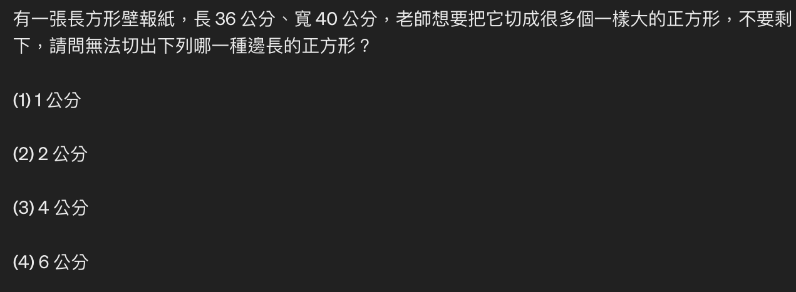
The importance of prompt designing
Without prompt designing, Gemini cannot solve the problem correctly.
Prompt : (Directly copying and pasting the math question)

Slide 6
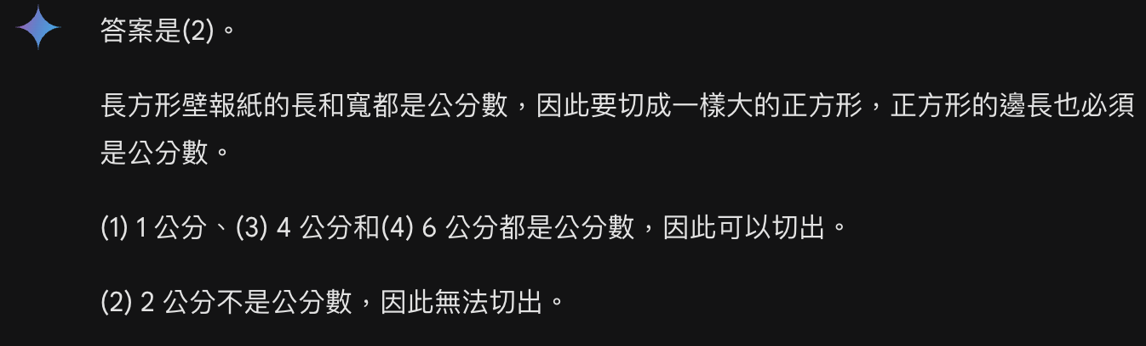
The importance of prompt designing
Without prompt designing, Gemini cannot solve the problem correctly.
Prompt : (Directly copying and pasting the math question)

Slide 7
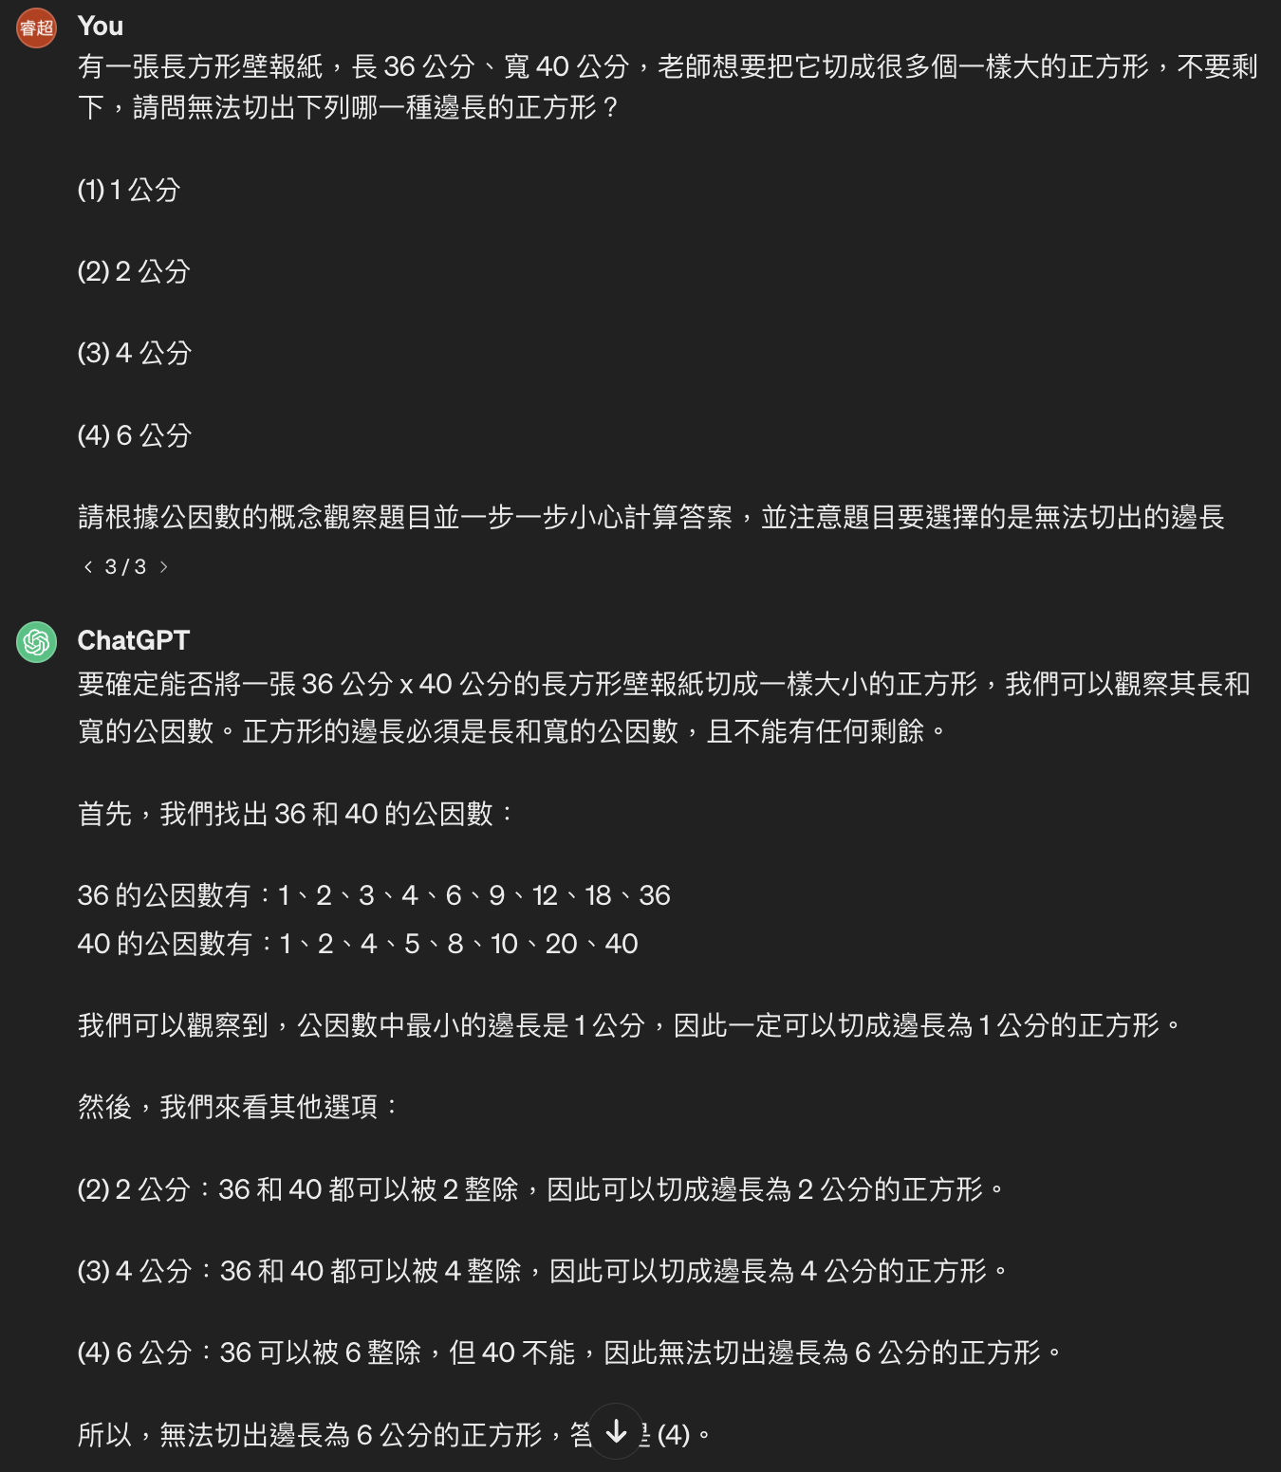
The importance of prompt designing
With prompt designing, Gemini outputs correct answer with explanation
Prompt : (Directly copying and pasting) + giving related information and detail

Slide 8
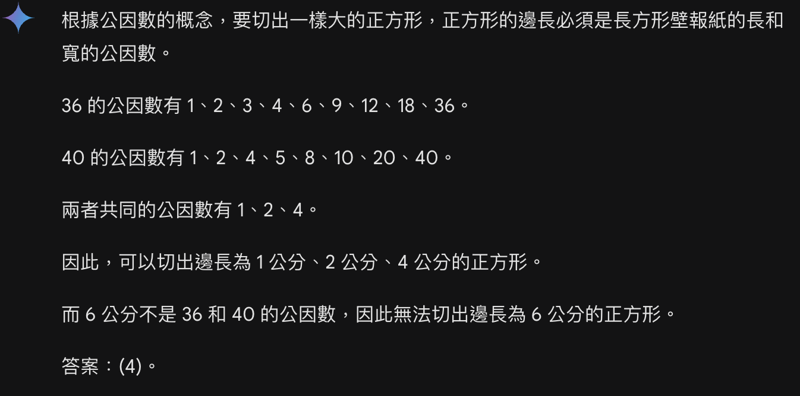
The importance of prompt designing
With prompt designing, Gemini outputs correct answer with explanation

Slide 9
Task Introduction

Slide 10
In HW4:
You need to design a prompt to help Gemini solve math problems more effectively.
We have provided 30 math problems; you need to come up with a prompt that will enable Gemini to consistently achieve higher accuracy on those problems.

Slide 11
In HW4:
An artist is creating a large mosaic using square tiles. The mosaic is designed to be a square itself and to contain exactly 3 times…….
Alright class, listen up! Today we're helping an artist with their mosaic project …
So the answer is 171 blue tiles + 57 red tiles = 228 tiles
Solve this problem as you are an elementary school math teacher:
Prompt
Math Problem
LLM
Answer
We will focus on this part !

Slide 12
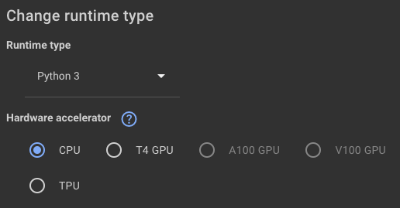
Workflow
HW4.ipynb - Colaboratory (google.com)
Step 0: Set up your Gemini API Key
Step 1: Design your prompt
Step 2: Check your prompt
Step 3: Evaluate your prompt
Step 4: Save and download your prompt
Note: We can see that there is no training required and just like HW3, we utilize Gemini API for this assignment. Therefore, No GPU resource is required.

Slide 13
Gradio and no Gradio Version
To avoid the inconvenience brought by gradio server crash, we prepare the codes that can be run without gradio
You only need to either run the codes with gradio or the codes without gradios. You DON’T need to run both of them

Slide 14
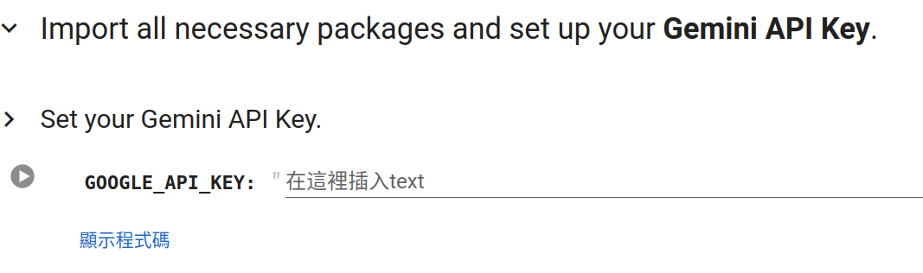
Step 0
Set up your Gemini API Key

Slide 15
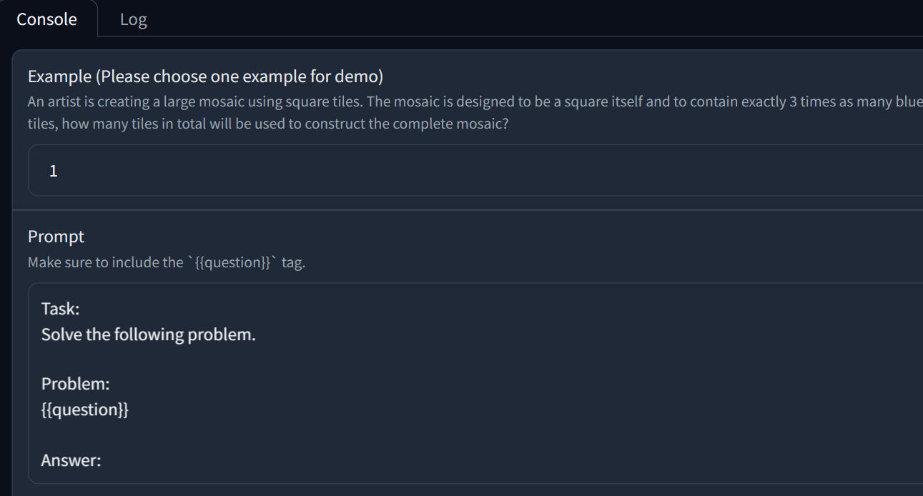
Step 1
Design your prompt.
Design your prompt to improve Gemini's performance in solving math problems.
You can write your prompt in this text box.

Slide 16
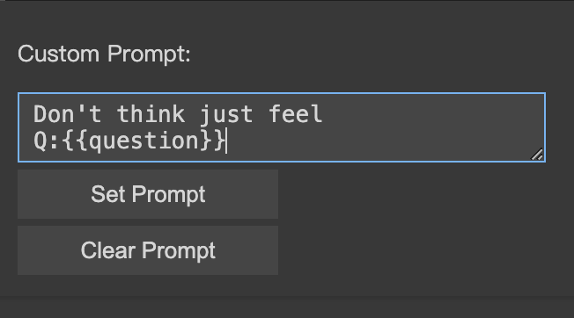
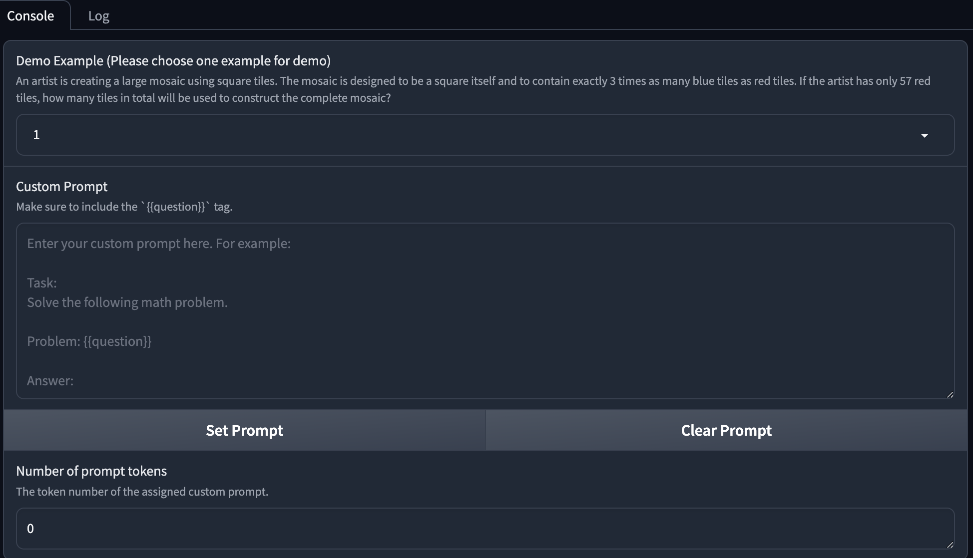
Step 1 - No Gradio Version
Design your prompt.
Design your prompt to improve Gemini's performance in solving math problems.
You can write your prompt in this text box.
No gradio
gradio

Slide 17
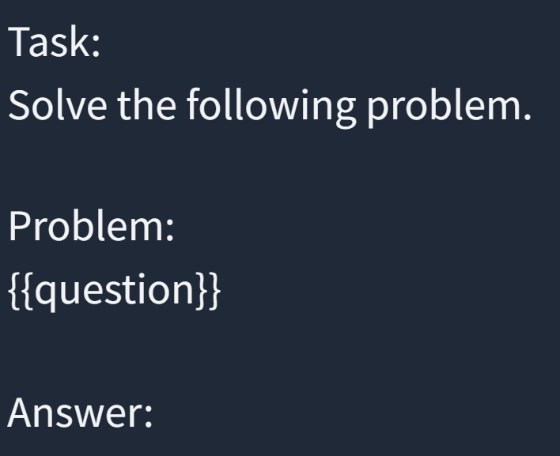
Step 1
Design your prompt.
Your prompt should be structured as a template with a placeholder: {{question}} for inserting a specific math problem.
Must include this structure with the {{question}} placeholder

Slide 18
Step 1
Design your prompt.
We will replace the {{question}} in your prompt with a real math question.
All the math questions will use the same prompt.
A farm has chickens and cows. If there are a total of 30 heads and 88 legs, how many cows are on the farm?
Task: Solve the following math problem.
Problem:
{{question}}
Answer
Task: Solve the following math problem.
Problem:
A farm has chickens and cows. If there are a total of 30 heads and 88 legs, how many cows are on the farm?
Answer
Math Problem

Slide 19
Step 1
Valid prompt examples:
Don’t think, just feel.
Q: {{question}}
A:
You are a math teacher.
Please solve this math problem.
{{question}}
Note: If you want to change line in the text box, use Shift + Enter.

Slide 20
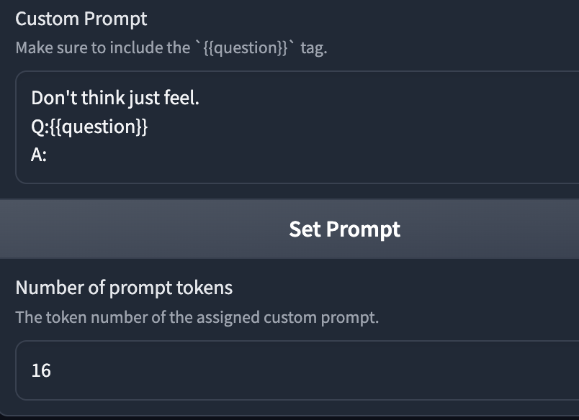
Step 2 -Gradio
1.
Check your prompt
Choose an example
Click set prompt button
2.
After setting prompt , It will calculate the tokens of your prompt
This button is for you to reset the prompt

Slide 21
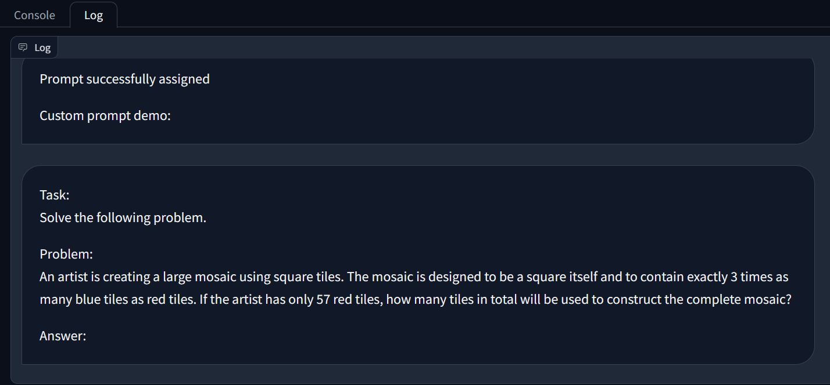
Step 2 - Gradio Version
Check your prompt in Log
Log is the history of interactions with Gradio.
This text will be the input of Gemini.

Slide 22
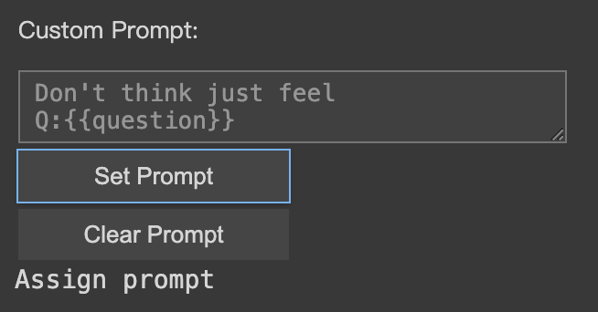
Step 2 - No Gradio Version
Fill in your prompt
Click set prompt button
After setting prompt , It will output a message to tell you’ve successfully assigned the prompt
This button is for you to reset the prompt

Slide 23
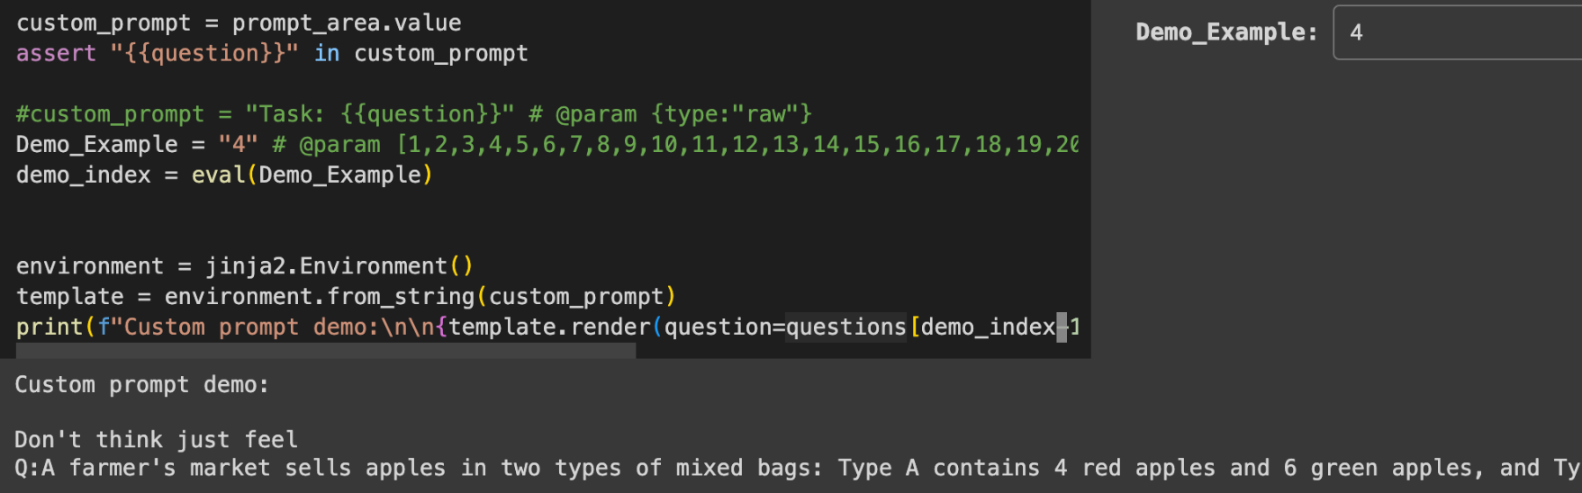
Step 2 - No Gradio Version
Check your prompt
Select demo and check custom prompt demo
Choose an example
This text will be the input of Gemini.

Slide 24
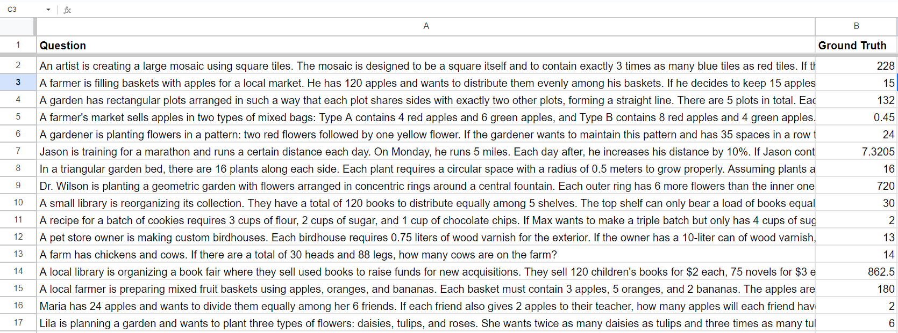
Step 2
We have provided some math problems: link
Each example contains one question and one answer

Slide 25
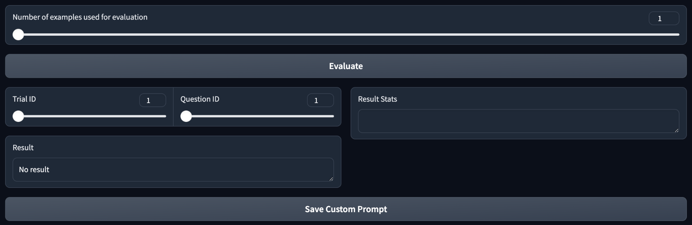
Step 3- Gradio version
Evaluate your prompt on the provided examples.
Select number of examples for assessing ( from 1 to 30 )
evaluate
You can also evaluate your prompt at https://gemini.google.com/app
1.
2.
3.

Slide 26
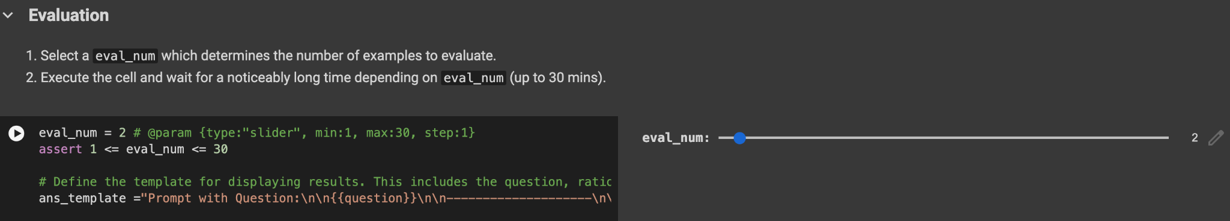
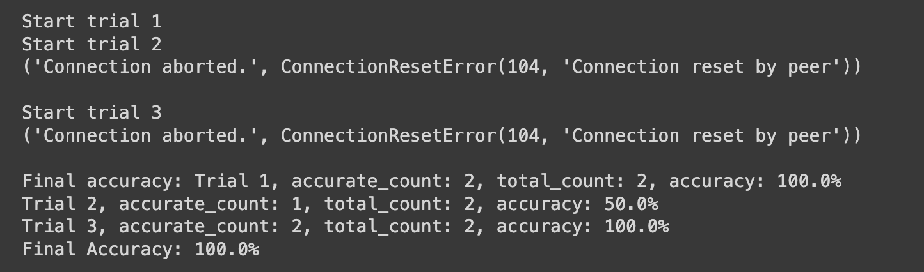
Step 3 - No Gradio Version
Evaluate your prompt on the provided examples.
Select number of examples for assessing ( from 1 to 30 )
evaluate
2.
1.
It will show the accurate question counts, total questions and your accuracy of each trial.
Output:

Slide 27
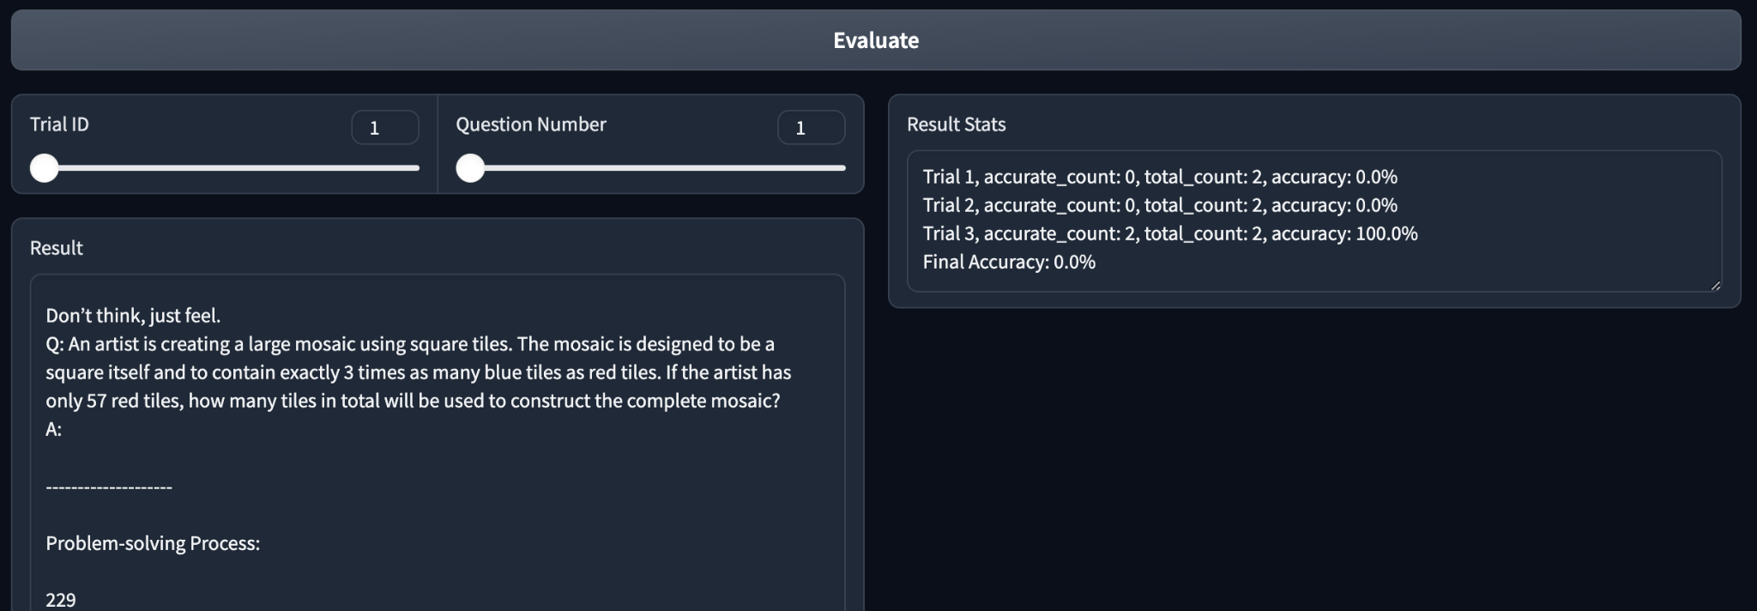
Step 4
After evaluation,check the answers generated by Gemini
Trial ID : Since your prompt will undergo three trials, you can select the answer from any specific trial.
Question ID: For the selected trial, you can select a particular question to review the answer generated by Gemini.

Slide 28
Step 4
After evaluation,check the answers generated by Gemini
Result : It will show Gemini’s response of the question from the specific trial.
Result Stat: It will show the accurate question counts, total questions and your accuracy of each trial.

Slide 29
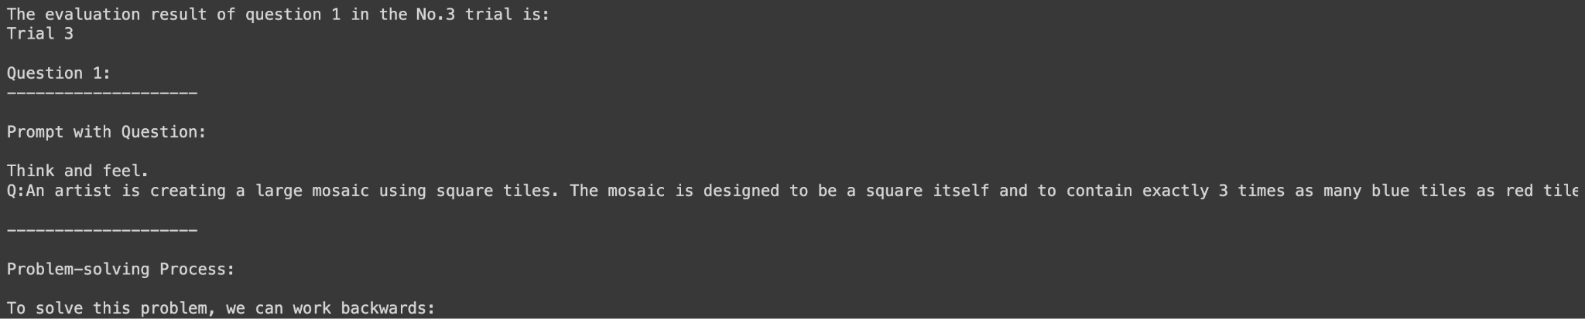
Step 4 - No Gradio Version
After evaluation,check the answers generated by Gemini
Result : It will show Gemini’s response of the question from the specific trial.
Output:

Slide 30
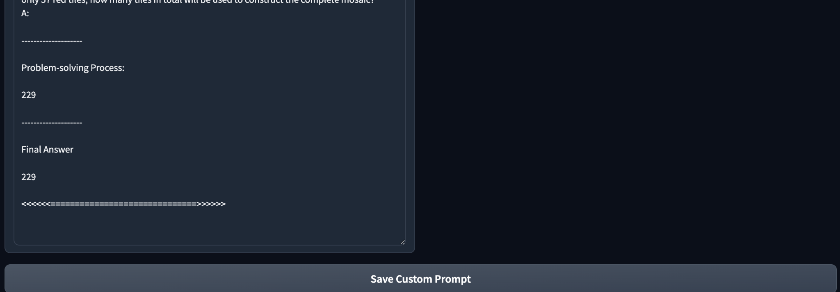
Step 5
Save and download your prompt
After you set your prompt, you can save your prompt by clicking Save Custom Prompt.

Slide 31
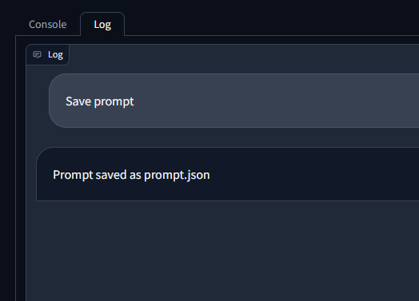
Step 5: Gradio version
Save and download your prompt
You can check if your prompt has been successfully saved in the log.

Slide 32
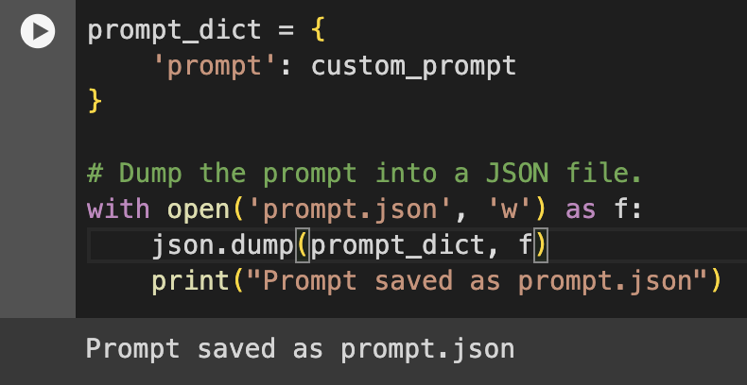
Step 5 - No Gradio Version
Save and download your prompt
You can check if your prompt has been successfully saved in the log.

Slide 33
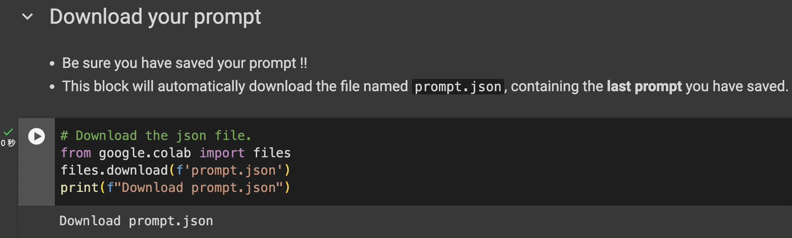
Step 5
Save and download your prompt
After executing the block, your prompt.json file will be download to your computer automatically.
If you want to use this block to download your prompt, make sure you have stopped the Gradio.
1.

Slide 34
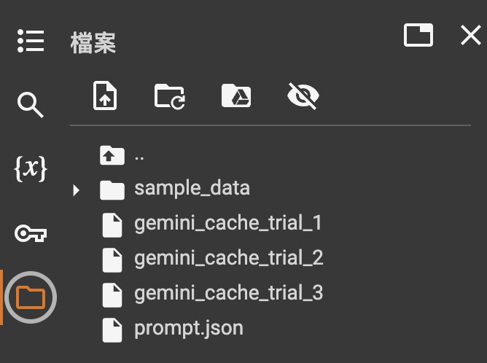
Step 5
Save and download your prompt
If the code block shown in p22 results in error, double check if there exists prompt.json.
1.

Slide 35
Issues You Might Encounter

Slide 36
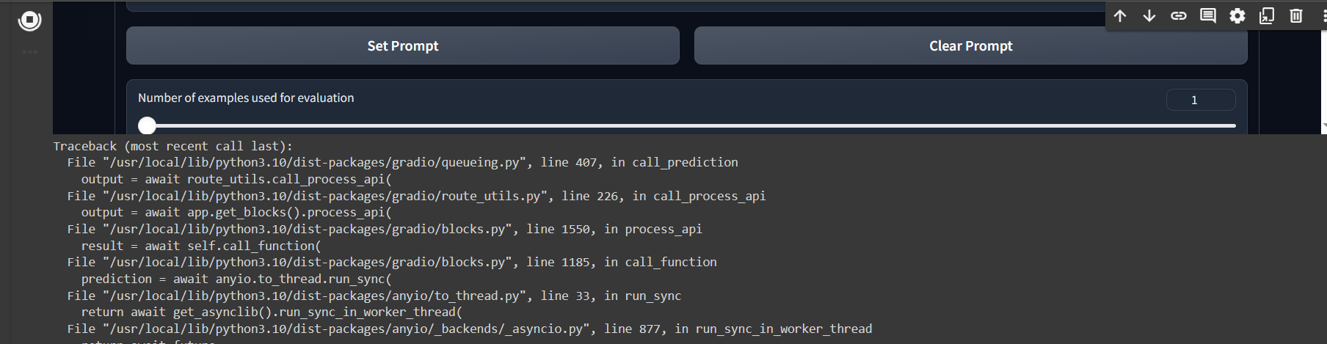
Error from code block (for debugging)
Just like HW3, you might encounter errors in this code block.
The output of the code block would be below the code block, you can try to debug from the traceback
Or when you need assistance from TA whether via NTU COOL or mail, please also provide screenshot of this part

Slide 37
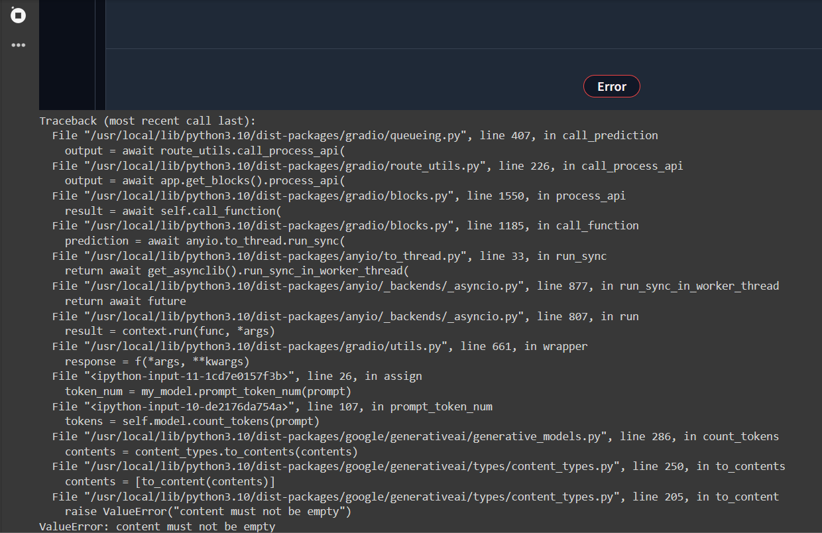
ValueError : content must not be empty
If you encounter this error
You pressed set prompt button before filling it

Slide 38
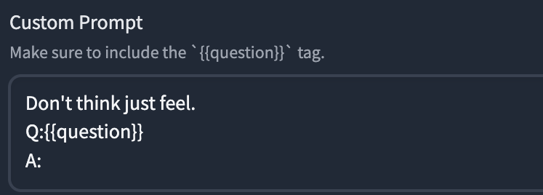
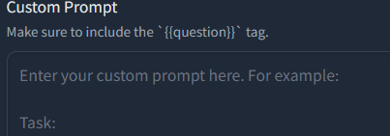
ValueError : content must not be empty
Solution: Restart the block and fill in the prompt correctly

Slide 39
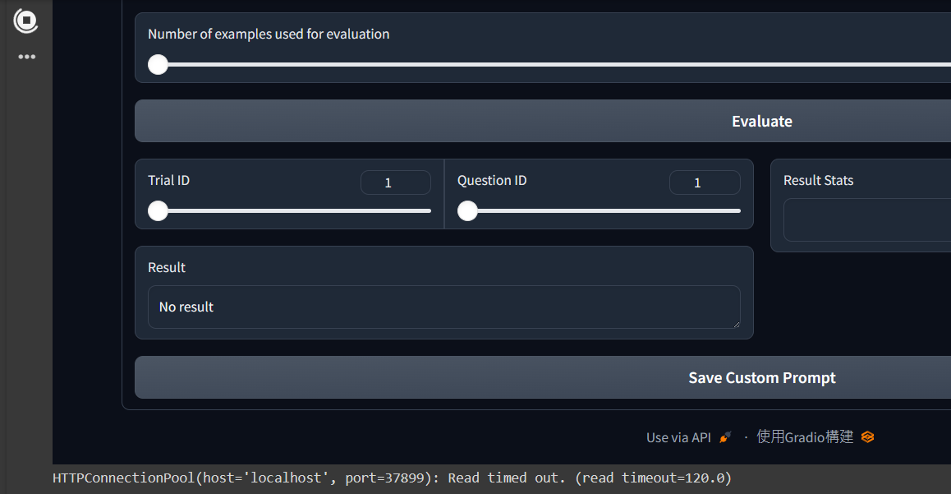
Read timed out
If you encounter these error:
This means that Gemini doesn’t provide any response.

Slide 40
Read timed out
Solution
This error usually occurs when Gemini is not properly terminated, such as when pressing the stop key of the Colab block while executing Evaluate. After encountering it once, any subsequent calls to Gemini will trigger a "Read timed out," so it is recommended to directly restart Colab.
Restart the colab.
If it still doesn’t work, restart the colab then change the prompt.

Slide 41
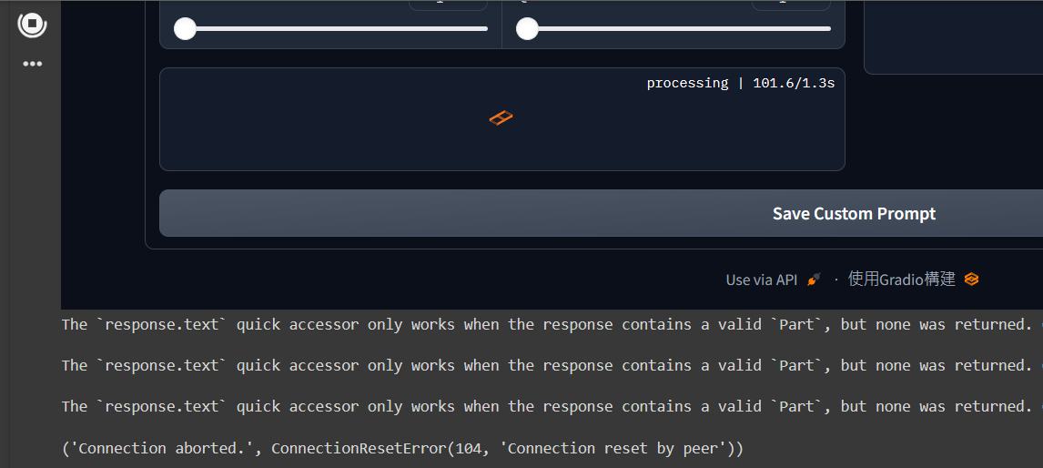
None was returned
If you encounter these error:
This means that Gemini doesn’t provide any response.

Slide 42
None was returned
Solution
Restart the colab.
If it still doesn’t work, change the prompt.

Slide 43
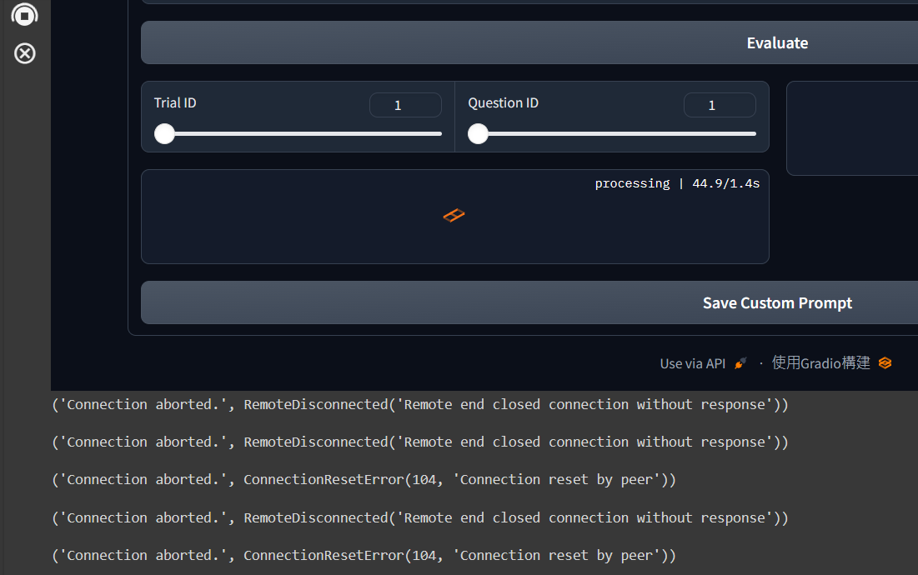
Connection aborted.
If you encounter this problem, just ignore it !!

Slide 44
Grading and Submission

Slide 45
Grading
You need to submit two prompts
We will evaluate the accuracy of gemini-pro on the public set math questions (with 30 questions) and a private set math questions (with 100 questions) using the prompts you submitted
Temperature: 1.0

Slide 46
Grading
For each math question, we will use a two-stage method to extract the answer from Gemini’s output
First Stage: Gemini will be asked to provide a problem-solving process using the prompt you provided.
Second Stage: Gemini will be requested to extract the final answer based on the problem-solving process given in the first stage. This step allows the TAs to parse the answer and calculate the accuracy automatically.
Use the prompt “The answer to the original question is (a number only):” to extract the final answer.

Slide 47
1st Stage
2nd Stage
Prompt
Question
An artist is creating a large mosaic using square tiles. The mosaic is designed to be a square itself and to contain exactly 3 times…….
Alright class, listen up! Today we're helping an artist with their mosaic project …
So the answer is 171 blue tiles + 57 red tiles = 228 tiles
The answer to the original question is (a number only):
Solve this problem as you are an elementary school math teacher:
An artist is creating a large mosaic using square tiles. The mosaic is designed to be a square itself and to contain exactly 3 times…….
Gemini
Alright class, listen up! Today we're helping an artist with their mosaic project …
So the answer is 171 blue tiles + 57 red tiles = 228 tiles
Gemini
228
We will only consider the extracted answer for each problem, regardless of the accuracy of the model's problem-solving process.

Slide 48
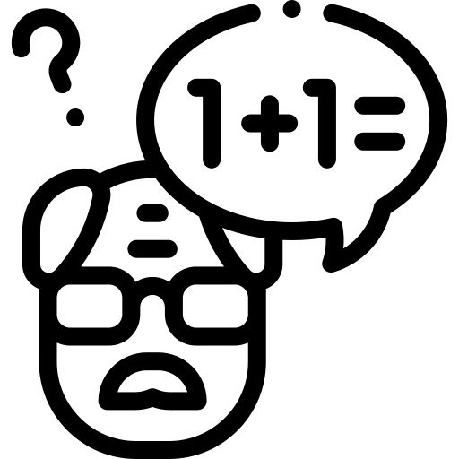
Grading
For each prompt, we will sample the answer of each question three times. A question will be considered correct only if it is answered correctly in at least two of the trials.
2
0
2
The final accuracy for each prompt will be determined by calculating the percentage of questions answered correctly.
Among the two prompts, we will only consider the one with a higher final accuracy.

Slide 49
Final Score
Average accuracy on 30 questions in public set
>= 0.60
+5pts
Average accuracy on 100 questions in private set
>= 0.62
+1pts
>= 0.67
+3pts
>= 0.72
+5pts

Slide 50
Disclaimers
Public Set
The questions in public and private set have no overlap
An artist is creating a large mosaic using square tiles. …
Accuracy on public set
Solve this problem as you are an elementary school math teacher:
A question from public set
??????????????????????????????
Accuracy on private set
Prompt
A question from private set
Private Set

Slide 51
Disclaimers
Public Set
The accuracy on the public and private set can be different
An artist is creating a large mosaic using square tiles. …
Accuracy on public set
Solve this problem as you are an elementary school math teacher:
A question from public set
??????????????????????????????
Accuracy on private set
Prompt
A question from private set
Private Set

Slide 52
Disclaimer (Emphasized again)
The public set and private set has no overlap. This is a realistic setting in machine learning problems
The accuracy on the public set can be (very) different from the private set
You cannot argue with the TA about your final score if you score high on the public set but score low on the private set.
Public Set
Private Set
Accuracy on public set
Accuracy on private set

Slide 53
Submission
Submit your homework to NTU Cool
We will open two submission areas for HW4, and each HW4 submission area can only receive one prompt.
Your submission file should be a .json file.
No late submission is allowed

Slide 54
Important Dates
Deadline for Submission (NTU Cool)
2024/04/04 23:59:59 (UTC+8)
Grading Release Date
2024/04/25 23:59:59 (UTC+8)

Slide 55
Regulations

Slide 56
Rules
Plagiarism in any form is prohibited.
Do NOT share your prompts with others.
第一次違反以上規定，該作業0分，學期總成績再乘以0.9
第二次違反以上規定，學期成績F
Prof. Lee & the TAs preserve the rights to change the rules & grades.

Slide 57
If You Have Any Questions
NTU Cool HW4 Forum
Recommended if no assignment answers or privacy issues are involved in your questions
Prioritize answering questions on the homework forum
Email: ntu-gen-ai-2024-spring-ta@googlegroups.com
Title should start with [GenAI 2024 Spring HW4]
Email with the wrong title will be moved to trash automatically
TA Hours
Time:
3/22(16:30 - 17:20)
3/29(13:20 - 14:10, 16:30 - 17:20)
Location: 綜合大講堂

Slide 58
Colab

Slide 59
Link
Colab: HW4.ipynb - Colaboratory (google.com)

Slide 60
Hints

Slide 61
Hint
Zero Shot Chain of Thought
Q: {{question}}
A: Let’s think step by step
[2205.11916] Large Language Models are Zero-Shot Reasoners (arxiv.org)

Slide 62
Hint
2. In-Context Learning
Q: Shawn has five toys.For Christmas, he got two toys each from his mom and dad.How many toys doe she have now?
A: He has 5 toys. He got 2 from mom, so after that he has 5+2=7 toys. Then he got 2 more from dad, so in total he has 7+2=9 toys. The answer is 9.
Q: {{question}}
A:
[2201.11903] Chain-of-Thought Prompting Elicits Reasoning in Large Language Models (arxiv.org)

Slide 63
Hint
3. Emotional Stimuli
Q: {{question}} This is very important to my career.
[2307.11760] Large Language Models Understand and Can be Enhanced by Emotional Stimuli (arxiv.org)

